Slide 1








Machine Learning M – 2023/24
FINAL PROJECT
Estimation of Obesity Levels based on Eating Habits and Physical Condition with Machine Learning
Aníbal Hernando Novo

Slide 2

Machine Learning M – 2023/24 – FINAL PROJECT
CONTENTS
INTRODUCTION
PREPROCESSING
Variables / Distribution of Variables / Importance of Variables – Random Forest
CLUSTERING
Probabilistic Model Based Clustering / Iterative Distance Based – K Means / Hierarchical Clustering / Dbscan
CLASSIFICATION
K Nearest Neighbors KNN / Support Vector Machine SVM / Decision Tree DT / Random Forest RF
CONCLUSION

Slide 3
Machine Learning M – 2023/24 – FINAL PROJECT
INTRODUCTION
Objectives
Aníbal Hernando Novo

Slide 4
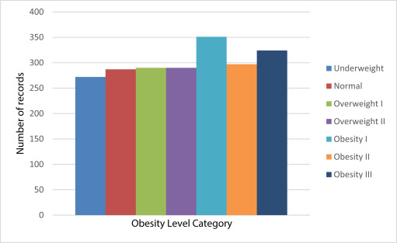
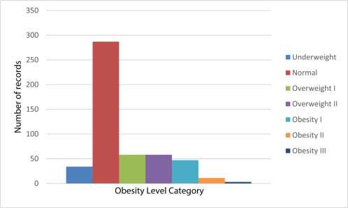
Machine Learning M – 2023/24 – FINAL PROJECT
dataset
Estimation of Obesity Levels based on healthy and physical habits
2111 instances and 17 features
No missing values
Variable ‘target’ based on IMC = weight(kg)/height(m)2
Levels:
Insufficient Weight: IMC <18,5
Normal Weight: IMC 18,5 - 24,9
Overweight Level I: IMC 25 -29.9
Overweight Level II: IMC 30-34.9
Obesity Level I: IMC 35-39,9
Obesity Level II (Morbid): IMC 40-49,9
Obesity Level III (Extreme): IMC >50
Figure 1. Imbalanced data (a), Balanced data (b)

Slide 5
Machine Learning M – 2023/24 – FINAL PROJECT
PREPOCESSING
Variables / Distribution of Variables / Importance of Variables – Random Forest
Aníbal Hernando Novo

Slide 6

Machine Learning M – 2023/24 – FINAL PROJECT
variables
continuous
categorical
binary
integer
GENDER
vegetables
physical activity
FCVC
FAF
AGE
NCP
nº of daily meals
TUE
tech time use
HEIGHT
CAEC
between meals
CALC
alcohol
WEIGHT
SMOKE
MTRANS
transport
FHWO
family history
CH20
daily water
NObesydad
obesity
FAVC
high caloric food
SCC
monitor calories

Slide 7
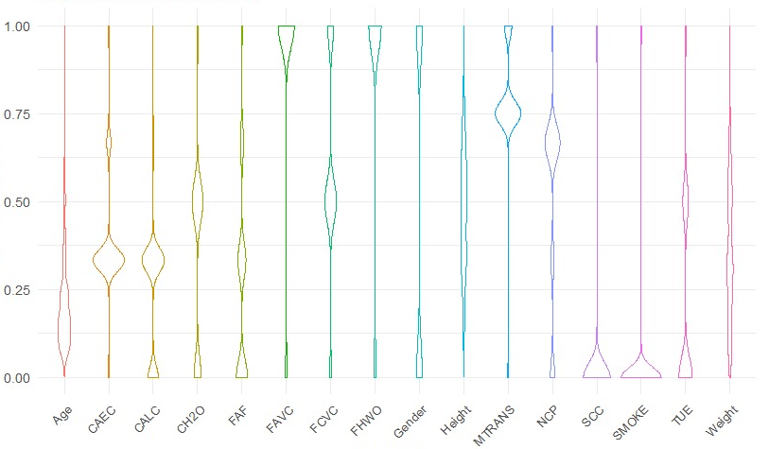
Machine Learning M – 2023/24 – FINAL PROJECT
distribution of variables
Figure 2. Distribution Normalization of the variables.

Slide 8
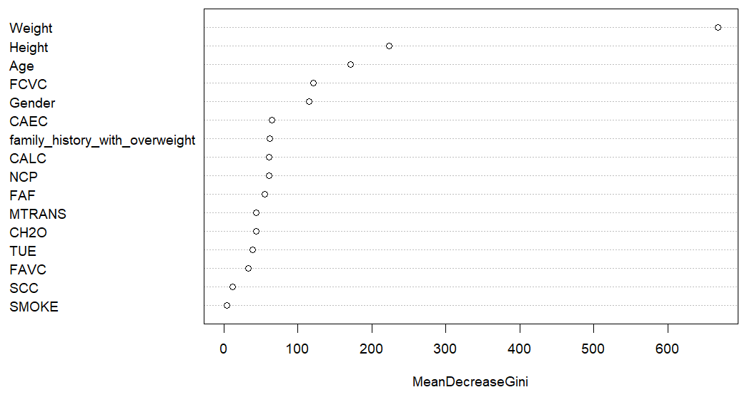
Machine Learning M – 2023/24 – FINAL PROJECT
importance of variables
Figure 3, Variable importance

Slide 9
Machine Learning M – 2023/24 – FINAL PROJECT
CLUSTERING
Probabilistic Model Based Clustering / Iterative Distance Based – K Means / Hierarchical Clustering / Dbscan
Aníbal Hernando Novo

Slide 10
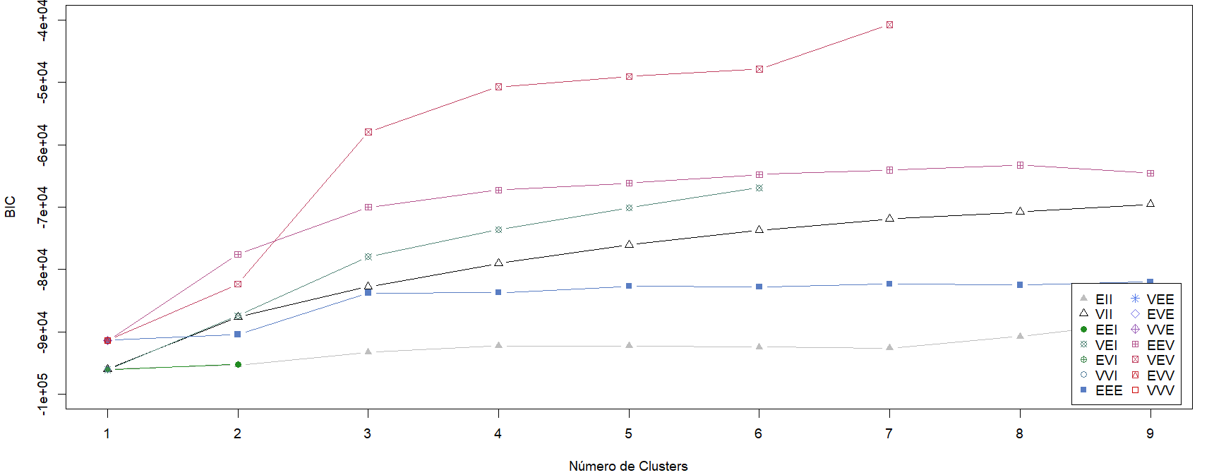
Machine Learning M – 2023/24 – FINAL PROJECT
probabilistic model-based clustering
Volume: variable / Shape: equal / Orientation: variable
Figure 4, BIC value criteria

Slide 11
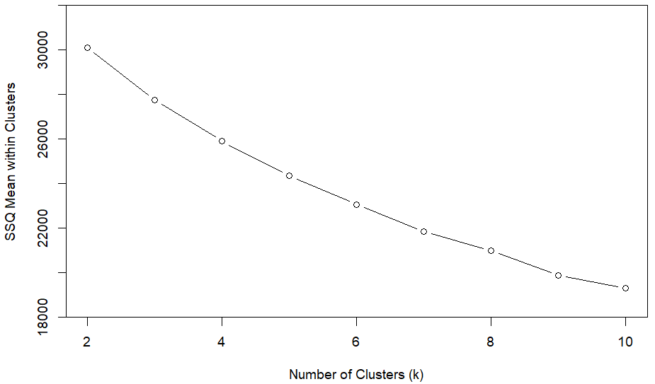
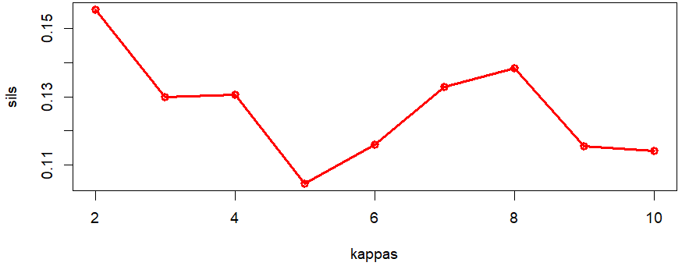
Machine Learning M – 2023/24 – FINAL PROJECT
validation methods
internal validation methods with K Means algorithm
Sum of squares SQQ distance to centroids
Silhouette coefficient for k = 2:10
Figure 5, SSQ plot
Figure 6, Average Silhouette Width

Slide 12
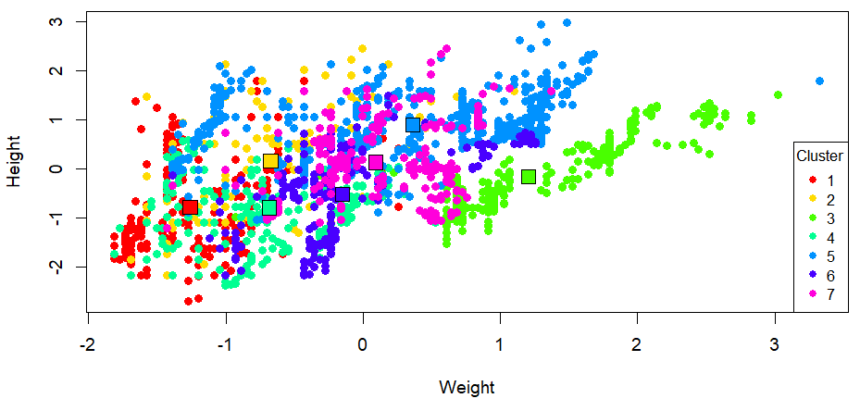
Machine Learning M – 2023/24 – FINAL PROJECT
iterative distance based – K Means
Figure 7. Clustering between Height and Weight

Slide 13
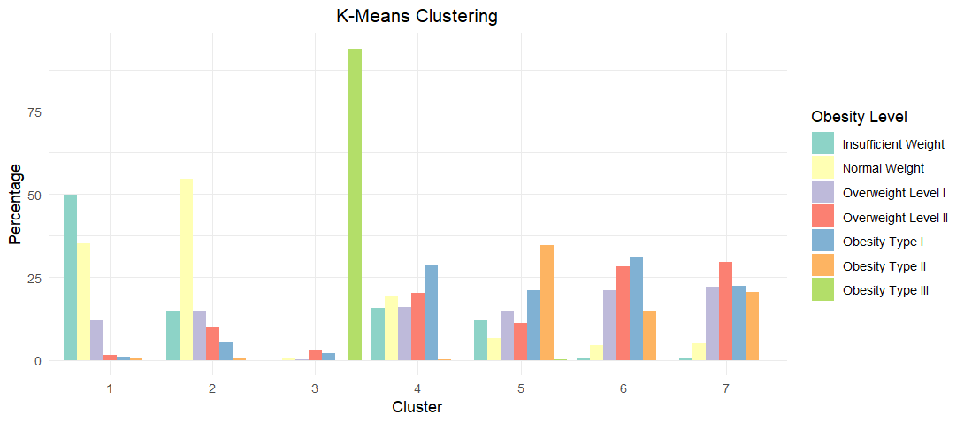
Machine Learning M – 2023/24 – FINAL PROJECT
iterative distance based – K Means
Figure 8. K Means clustering bar plot for k=7

Slide 14
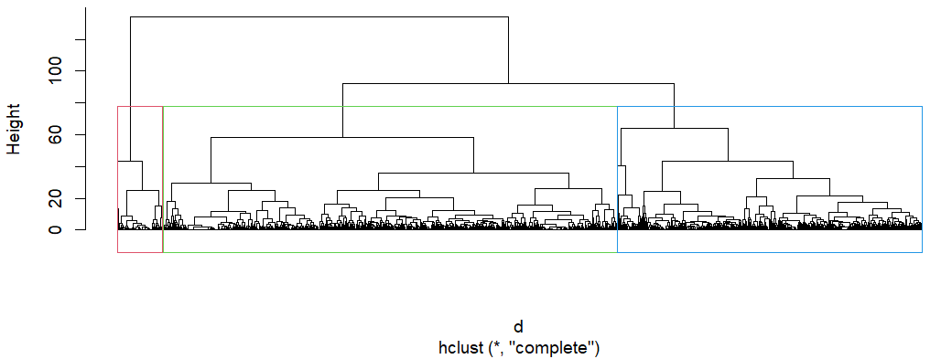
Machine Learning M – 2023/24 – FINAL PROJECT
hierarchical clustering
Figure 9. Cluster Dendogram

Slide 15
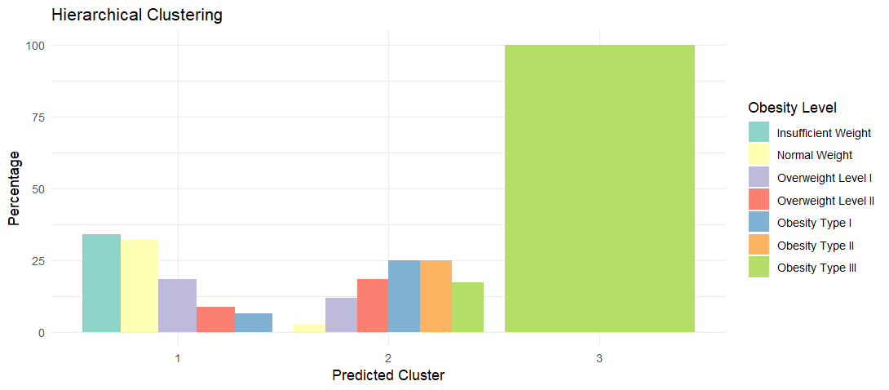
Machine Learning M – 2023/24 – FINAL PROJECT
hierarchical clustering
Figure 10. Hierarchical clustering

Slide 16


Machine Learning M – 2023/24 – FINAL PROJECT
dbscan
Function with parameters:
ε radius of the sphere ∈ (0.3,0.9)
τ number of contain points ∈ (5,30)
Compares the mean silhouette using Dbscan.
Best ε = 0.49 and τ = 26 and the silhouette = 0.02.
Problem
Noise points = 1816 of 2111 instances
Silhouette works bad if clusters has arbitrary shape

Slide 17
Machine Learning M – 2023/24 – FINAL PROJECT
CLASSIFICATION
K Nearest Neighbors - KNN / Support Vector Machine - SVM / Decision Tree- DT / Random Forest - RF
Aníbal Hernando Novo

Slide 18
Machine Learning M – 2023/24 – FINAL PROJECT
k – nearest neighbors KNN
0: Insufficient Weight, 1: Normal Weight, 2: Overweight Level I, 3: Overweight Level II, 4: Obesity Type I, 5: Obesity Type II and 6: Obesity Type III

Slide 19
Machine Learning M – 2023/24 – FINAL PROJECT
support vector machine SVM
0: Insufficient Weight, 1: Normal Weight, 2: Overweight Level I, 3: Overweight Level II, 4: Obesity Type I, 5: Obesity Type II and 6: Obesity Type III

Slide 20
Machine Learning M – 2023/24 – FINAL PROJECT
decision tree DT
0: Insufficient Weight, 1: Normal Weight, 2: Overweight Level I, 3: Overweight Level II, 4: Obesity Type I, 5: Obesity Type II and 6: Obesity Type III

Slide 21
Machine Learning M – 2023/24 – FINAL PROJECT
random forest RF
0: Insufficient Weight, 1: Normal Weight, 2: Overweight Level I, 3: Overweight Level II, 4: Obesity Type I, 5: Obesity Type II and 6: Obesity Type III

Slide 22
Machine Learning M – 2023/24 – FINAL PROJECT
CONCLUSION
Aníbal Hernando Novo

Slide 23
Machine Learning M – 2023/24 – FINAL PROJECT
In clustering, K-means and Hierarchical Clustering shows the difference between Obesity Level Type III and the other levels. Good homogeneity in this class.
In classification, we achieve the best accuracy in Random Forest (96,9%). The sensibility in RF has lower values in Normal and Overweight Level I like all methods. So, exists a trend to misclassify these classes.
We have seen that Machine Learning methods have high accuracy, (except Decision Tree) being a good way to classify people based in previous healthy and physical features.
These techniques can be used in health centers or hospitals to check the patient’s obesity level, because early actions could prevent future diseases related to this obesity problems.

Slide 24
Machine Learning M – 2023/24
FINAL PROJECT
Thank you for your attention
Aníbal Hernando Novo

